Slide 1
Data Structures
Course code: cs-201
Topic: Minimum spanning tree
Instructor: habiba arshad

Slide 2
Today’s Goal
Minimum spanning tree
Prim’s Algorithm
Kruskal Algorithm

Slide 3
Minimum Spanning Tree
What is spanning tree?
Set of edges that connect all nodes of graph and doesn’t form a cycle.
What is Minimal spanning tree?
The subset of edges that connects all vertices in the graph and has minimum total weight.

Slide 4
What is MST
A spanning tree of a graph G is a subgraph T that is connected and acyclic.
There are n nodes in a graph and spanning tree consist of n-1 edges such that no cycles are formed.

Slide 5
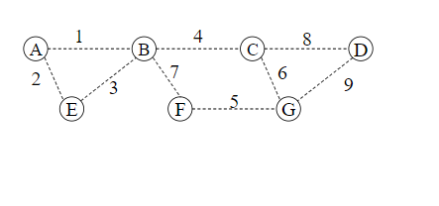
Cycle Property

Slide 6
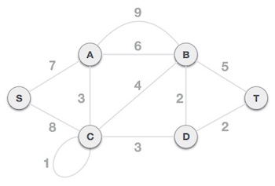
Graph

Slide 7
Steps for Prim’s Algorithm
Remove all loops and parallel edges from the given graph.
In case of parallel edges, keep the one which has the least cost associated and remove all others.
Choose any arbitrary vertex as root node
Check out all the outgoing edges from the vertex (keep check the previous vertex) and select the one having minimum edge.
Should not contain cycle
Keep checking the previous vertex also

Slide 8
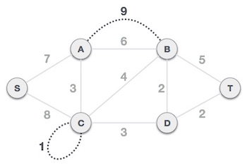
Prim’s Algorithm Step 1 - Remove all loops and parallel edges

Slide 9
Step 2 - Choose any arbitrary node as root node
Choose S node as the root node of Prim's spanning tree. This node is arbitrarily chosen, so any node can be the root node.

Slide 10
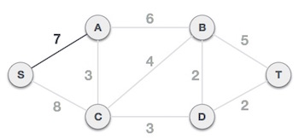
Step 3 - Check outgoing edges and select the one with less cost
S-7-A is treated as one node and we check for all edges going out from it

Slide 11
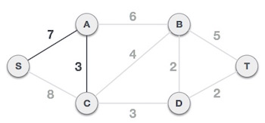
S-7-A-3-C tree is formed

Slide 12
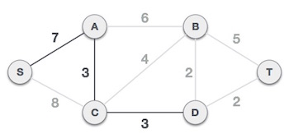
S-7-A-3-C-3-D

Slide 13
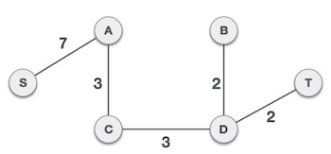
FINAL SPANING TREE

Slide 14
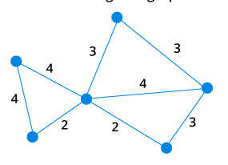
PRIMS EXERCISE

Slide 15
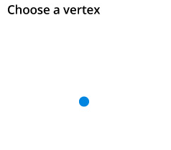

Slide 16
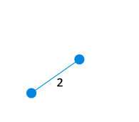

Slide 17
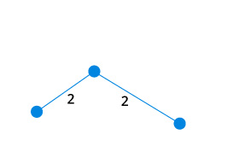

Slide 18
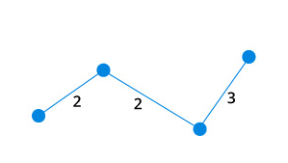

Slide 19
Application of spanning tree
Design Routing Protocol
Road Construction

Slide 20
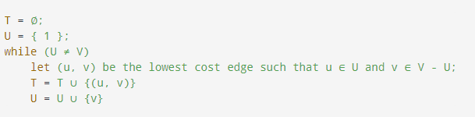
Pseudocode-Prim’s algorithm
Notes:
‘U’ contains the list of vertices that have been visited.
‘V-U’ the list of vertices that haven't been visited yet.

Slide 21
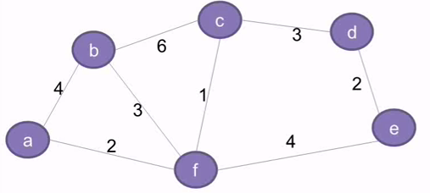
Prims (mst) algorithm example

Slide 22
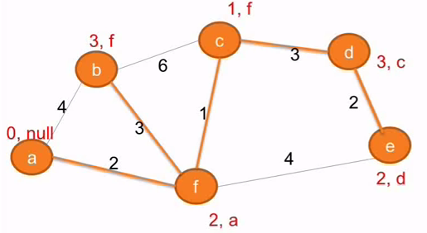
Prims (mst) algorithm example

Slide 23
Kruskal's algorithm

Slide 24
Kruskal's algorithm
Treats the graph as a forest and every node it has as an individual tree.
tree connects to another only and only if, it has the least cost among all available options and does not violate MST properties.

Slide 25
Steps for Kruskal’s Algorithm
Remove all loops and parallel edges from the given graph.
In case of parallel edges, keep the one which has the least cost associated and remove all others.
Arrange all vertex according to edge weights
When connecting the two vertices keep check that it should not contain any cycle.

Slide 26
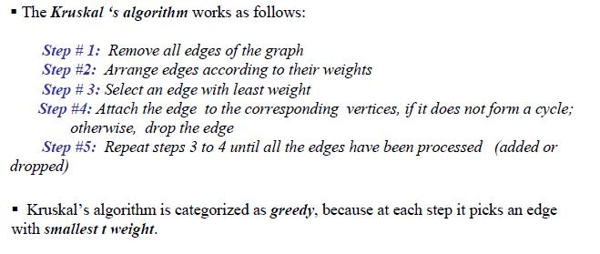
Kruskal’s algorithm

Slide 27
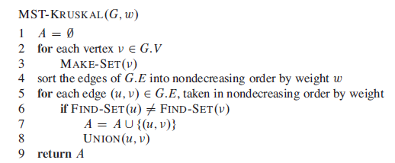
Pseudocode-Kruskal’s algorithm
Notes:
Given a set of objects:
Union: connect two objects.
Find: is there a path connecting the two objects?

Slide 29
Step 1 - Remove all loops and Parallel Edges

Slide 30
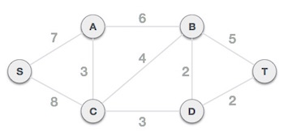

Slide 31
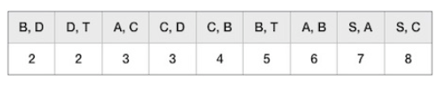
Step 2 - Arrange all edges in their increasing order of weight

Slide 32
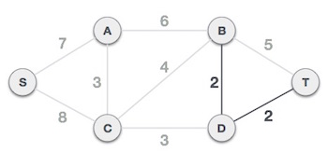
Step 3 - Add the edge which has the least weight

Slide 33
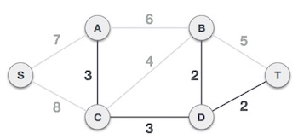

Slide 34
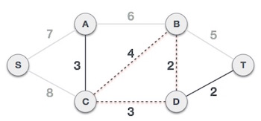
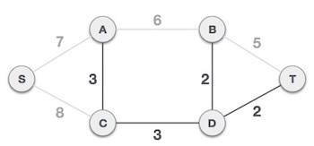

Slide 35
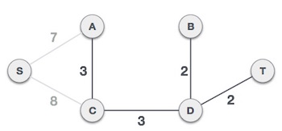

Slide 36
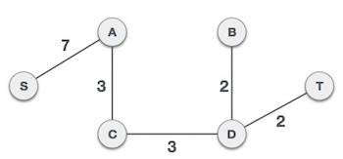

Slide 37
Dijkstra Algorithm
Dijkstra Algorithm is a graph algorithm for finding the shortest path from a source node to all other nodes in a graph(single source shortest path).
It is a type of greedy algorithm.
It only works on weighted graphs with positive weights.

Slide 38
General Description
Suppose we want to find a shortest path from a given node s to other nodes in a network (one-to-all shortest path problem)
Dijkstra’s algorithm solves such a problem
It finds the shortest path from a given node s to all other nodes in the network
Node s is called a starting node or an initial node
How is the algorithm achieving this?
Dijkstra’s algorithm starts by assigning some initial values for the distances from node s and to every other node in the network
It operates in steps, where at each step the algorithm improves the distance values.
At each step, the shortest distance from node s to another node is determined

Slide 39
Formal Description
The algorithm characterizes each node by its state The state of a node consists of two features:
distance value and status label
Distance value of a node is a scalar representing an estimate of the its distance from node s.
Status label is an attribute specifying whether the distance value of a node is equal to the shortest distance to node s or not.
The status label of a node is Permanent if its distance value is equal to the shortest distance from node s
Otherwise, the status label of a node is Temporary
The algorithm maintains and step-by-step updates the states of the nodes At each step one node is designated as current

Slide 40
Notation
In what follows:
d_{ℓ} denotes the distance value of a node ℓ.
p or t denotes the status label of a node, where p stand for permanent and t stands for temporary
c_{ij} is the cost of traversing link (i, j) as given by the problem
The state of a node ℓ is the ordered pair of its distance value d_{ℓ} and its status label.

Slide 41
Algorithm Steps
Step 1. Initialization
Assign the zero distance value to node s, and label it as Permanent. [The state of node s is (0, p).]
Assign to every node a distance value of ∞ and label them as
Temporary. [The state of every other node is (∞, t).]
Designate the node s as the current node

Slide 42
Step 2. Distance Value Update and Current Node Designation Update Let i be the index of the current node.
Find the set J of nodes with temporary labels that can be reached from the current node i by a link (i, j). Update the distance values of these nodes.
For each j ∈ J , the distance value d_{j} of node j is updated as follows
new d_{j} = min{d_{j}, d_{i} + c_{ij} }
where c_{ij} is the cost of link (i, j), as given in the network problem.
Determine a node j that has the smallest distance value d_{j} among all nodes j ∈ J ,
find j∗ such that
min d_{j} = d_{j}∗
j∈J
(3) Change the label of node j∗ to permanent and designate this node as
the current node.

Slide 43
Step 3. Termination Criterion If all nodes that can be reached from node s have been permanently labeled, then stop - we are done.
If we cannot reach any temporary labeled node from the current node, then all the temporary labels become permanent - we are done.
Otherwise, go to Step 2.

Slide 44
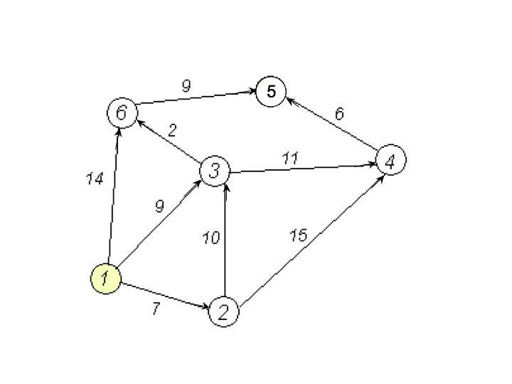
Dijkstra’s Algorithm: Example
We want to find the shortest path from node 1 to all other nodes using Dijkstra’s algorithm.

Slide 45
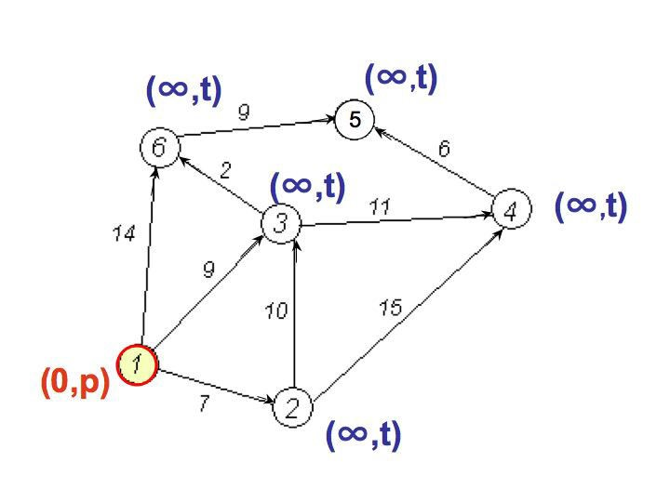
Initialization - Step 1
Node 1 is designated as the current node
The state of node 1 is (0, p)
Every other node has state (∞, t)

Slide 46
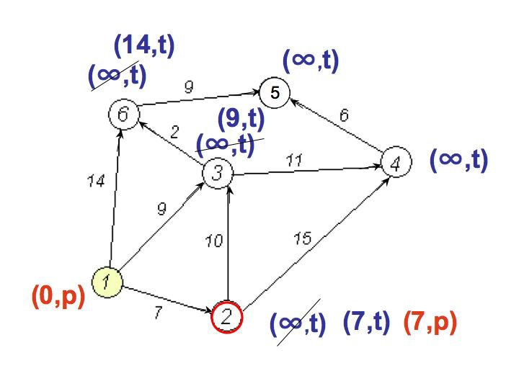
Step 2
Nodes 2, 3,and 6 can be reached from the current node 1
Update distance values
for these nodes
d₂ = min{∞, 0 + 7} = 7
d₃ = min{∞, 0 + 9} = 9
d₆ = min{∞, 0 + 14} = 14
Now, among the nodes 2, 3, and 6, node 2 has the smallest distance value
The status label of node 2 changes to permanent, so its state is (7, p), while the status of 3 and 6 remains temporary
Node 2 becomes the current node

Slide 47
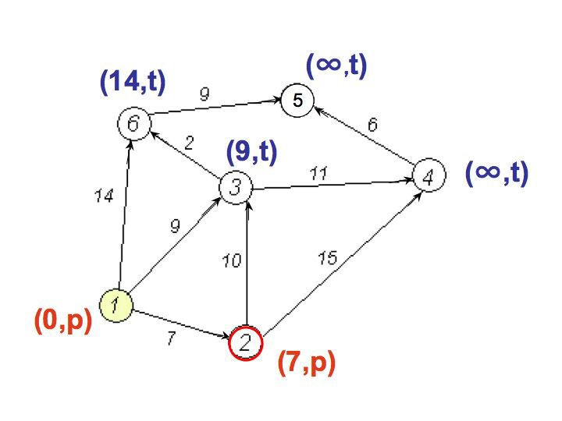
Step 3
Graph at the end of Step 2
We are not done,not all nodes have been reached from node 1, so we perform another iteration (back to Step 2)

Slide 48
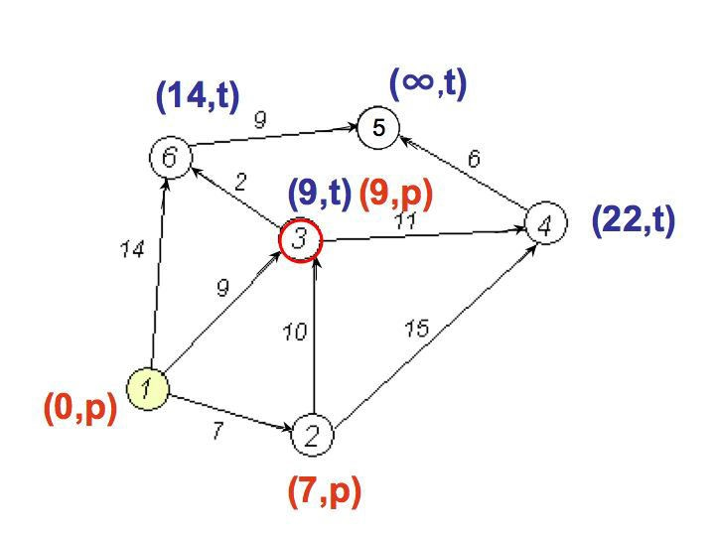
Another Implementation of Step 2
Nodes 3 and 4 can be reached from the current node 2
Update
distance values for these nodes
d₃ = min{9, 7 + 10} = 9
d₆ = min{∞, 7 + 15} = 22
Now, between the nodes 3 and 4 node 3 has the smallest distance value
The status label of node 3 changes to permanent, while the status of 6 remains temporary
Node 3 becomes the current node
We are not done (Step 3 fails), so we perform another Step 2

Slide 49
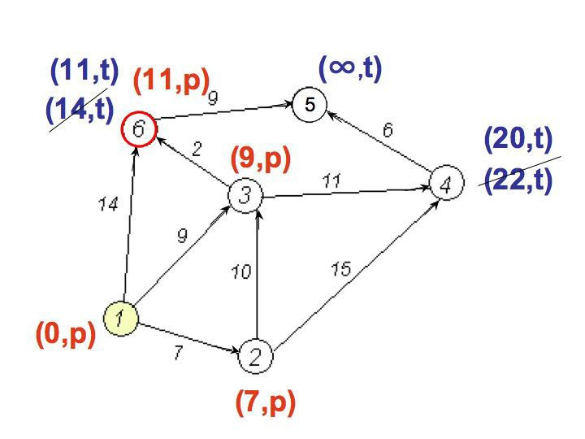
Another Step 2
Nodes 6 and 4 can be reached from the current node 3
Update distance values for them
d₄ = min{22, 9 + 11} = 20
d₆ = min{14, 9 + 2} = 11
Now, between the nodes 6 and 4 node 6 has the smallest distance value
The status label of node 6 changes to permanent, while the status of 4 remains temporary
Node 6 becomes the current node
We are not done (Step 3 fails), so we perform another Step 2

Slide 50
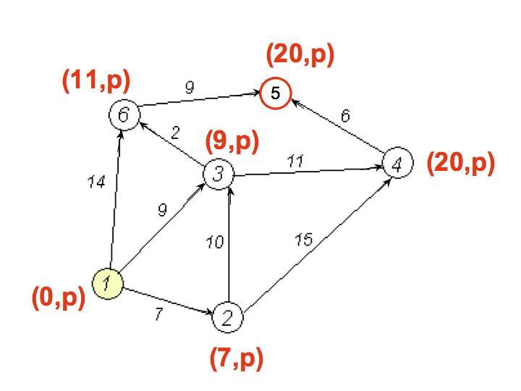
Another Step 2
Node 5 can be reached from the current node 6
Update distance value for node 5
d₅ = min{∞, 11 + 9} = 20
Now, node 5 is the only candidate, so its status changes to permanent
From node 5 we cannot reach any other node. Hence, node 4 gets permanently labeled and we are done.

Slide 51
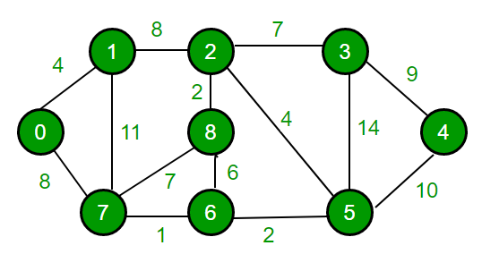
Dijkstra Algorithm

Slide 52
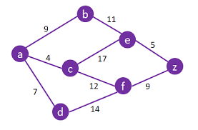
Dijkstra Algorithm

Slide 53
Applications of graph
Social media sites (facebook etc.)
Google maps
Networking

